Slide 1


AGRI HELP
Connecting Farmers
TEAMATES:
MENTOR
RAHU SANJAY J
221701045
MR. PRADEEP KUMAR
ASSISTANT PROFESSOR
SANTHRU P
221701049
CSD

Slide 2



ABSTRACT
This app helps small-scale farmers connect directly with local markets, check daily product prices using voice search and pictures, and manage their supply chain by tracking product weight. It enables farmers to keep more of their earnings and create a more efficient, profitable marketplace.

Slide 3


INTRODUCTION
Our app also helps farmers understand what sells and when by analyzing monthly sales data for each product. This allows them to identify periods of high and low demand: With easy-to-use features like voice search and picture-based price checking, farmers can easily stay updated on daily market prices. They can track the weight of their products and manage their supply chain more effectivelyFarmers can plan how much to grow, set the right prices, and decide the best times to sell.Farmers can plan how much to grow, set the right prices, and decide the best times to sell

Slide 4
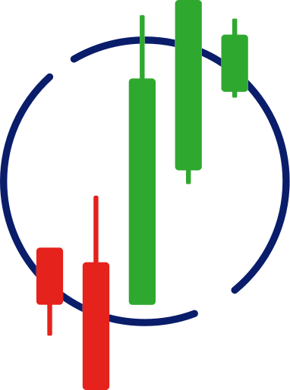
OBJECTIVE
Real-Time Market Updates
Enable Efficient Supply Chain Management
Analyze Sales Trends
Support Informed Decision-Making

Slide 5

LITERATURE SURVEY
Website
Author
Year
Remarks
www.agrimark.tn.gov.in
Not show regular price
TN govt
2023
www.tnagrisnet.tn.gov.in
Not show Ulavar Sandai Information
TN govt
2019

Slide 6
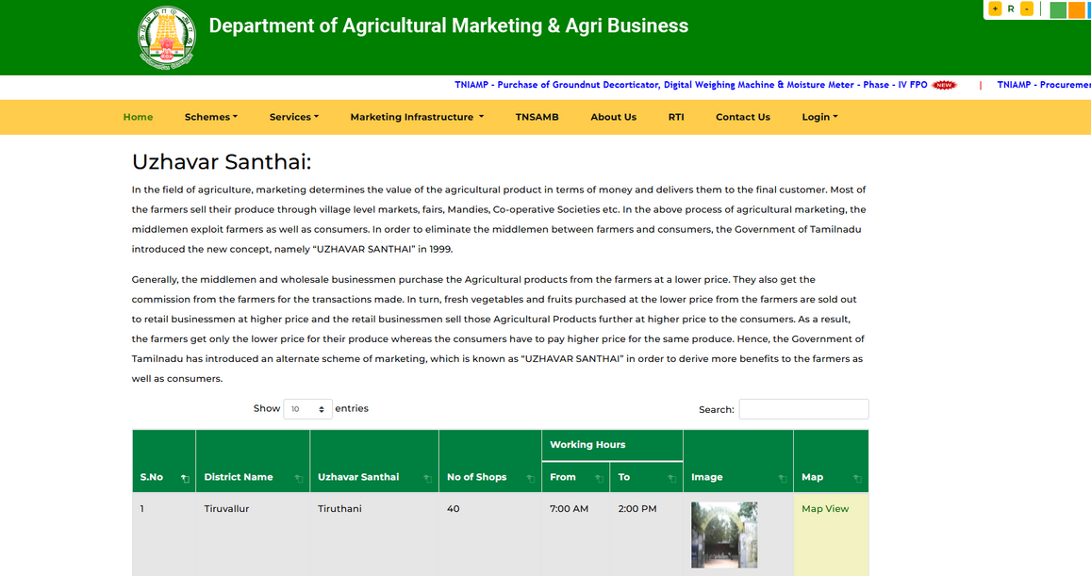
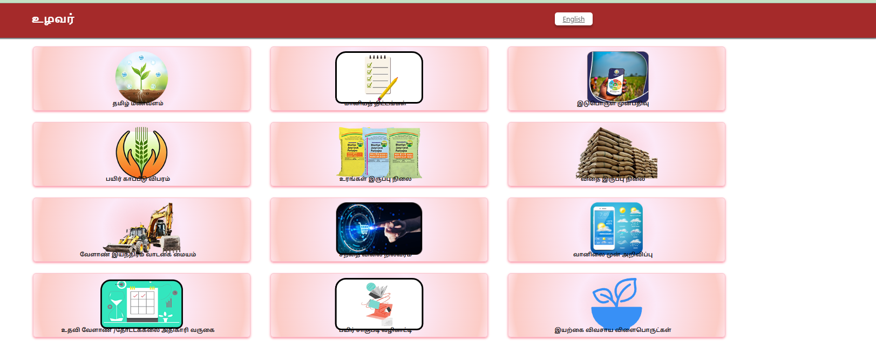
WEBSITES

Slide 7
METHODOLOGY
Requirement
Analysis
Data collection
Data Analysis
Decision Support
User-Friendly Interface

Slide 8

TECHNICAL IMPLIMENTATION
FRONTEND : HTML,CSS,JAVASCRIPT
BACKEND : NODE.JS,JAVASCRIPT
DATABASE : MONGODB
ANALYSIS : PYTHON

Slide 9
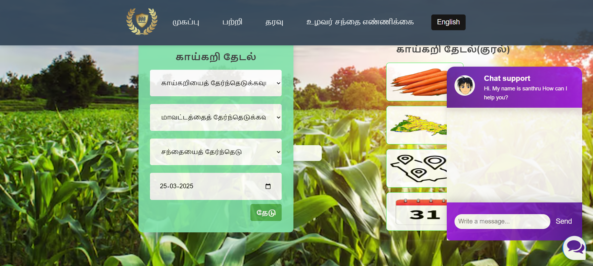
Expected output:

Slide 10
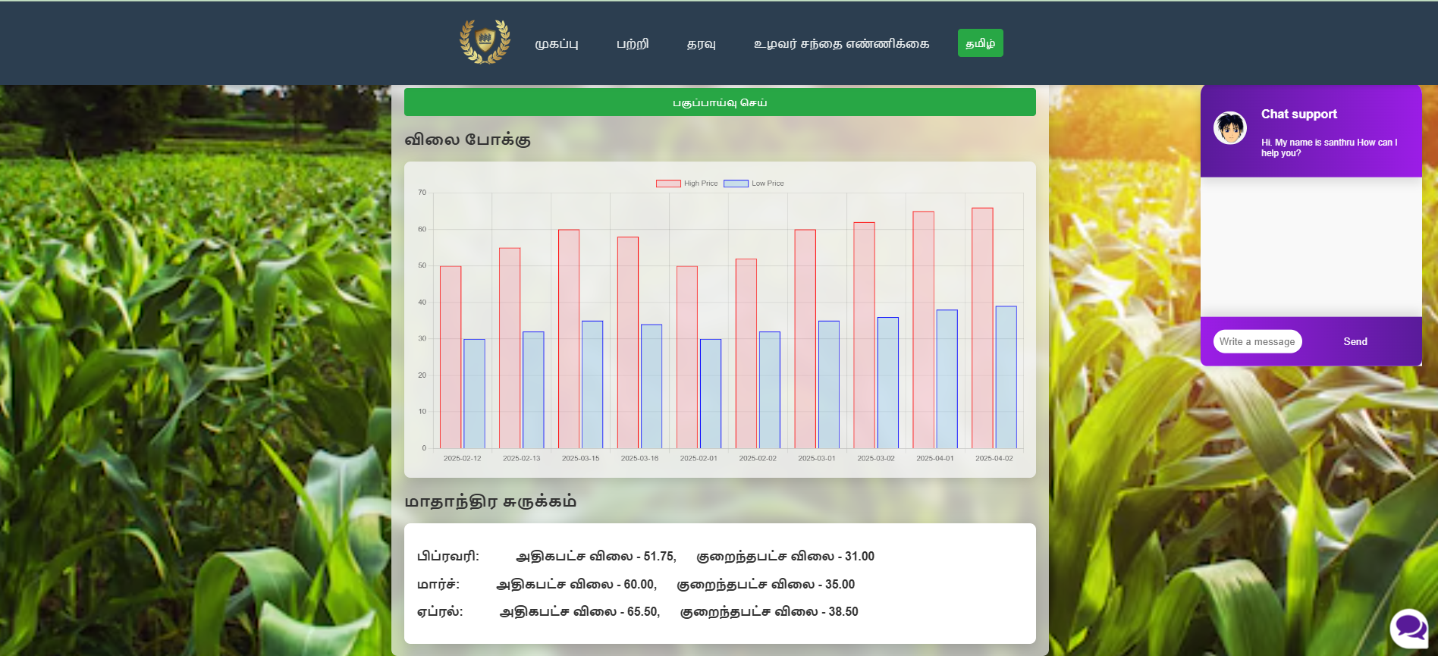
Expected output:

Slide 11
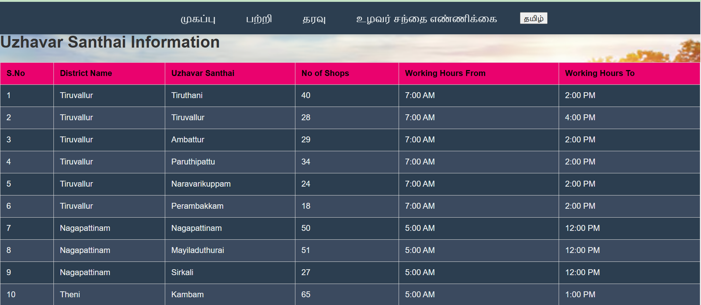
Expected output:

Slide 12

THANK YOU

